Slide 1
Price Controls
6
Notes:
Pre-class music: “Minimum Wage” by Fenix TX (See Tip #202)
You can use this song to introduce a preliminary discussion on the minimum wage before you begin your lecture on this chapter. Some initial questions you can ask students are:
Why does the government impose a minimum wage?
What are some possible negative consequences of a minimum wage?

Slide 2
Previously—1
Consumer surplus is the difference between what a consumer is willing to pay and the price paid.
Producer surplus is the difference between the minimum price a producer is willing to accept and the price received.
An outcome is efficient when an allocation of resources maximizes total surplus.

Slide 3
Previously—2
Taxing specific goods leads to a deadweight loss, which reflects reduced economic activity.
Taxing goods with an inelastic demand and/or supply leads to a smaller deadweight loss.

Slide 4
Big Questions
When do price ceilings matter?
What effects do price ceilings have on economic activity?
When do price floors matter?
What effects do price floors have on economic activity?
Notes:
Lecture notes:
You can introduce the “Big Questions” by mentioning the following points to students:
Price ceilings are legally established maximum prices for goods or services.
Price floors are legally established minimum prices for goods or services.
Although ceilings and/or floors might have good intentions, it is important to think about unintended consequences.

Slide 5
What Are Price Controls?
Price controls
  Attempt to set, or manipulate, prices through government involvement in the market
Price ceiling
  Legally established maximum price for a good or service
Price floor
  Legally established minimum price for a good or service
Notes:
Lecture notes:
Ask students why they think the government imposes price controls.
Imposes ceilings when the market price is “too high”
Intended to help consumers
Imposes floors when the market price is “too low”
Intended to help producers
At this point, stress that there is a difference between a binding and non-binding price control. This will be further explained on the next slide.

Slide 6
How to Remember Price Controls
Look at the ceiling in the classroom. Is it causing you any problems?
  What happens if the ceiling is only 4 feet high?
Look at the floor. Can you still get to your desk at the current floor height?
  What if the floor was too high?
  You would have to change your behavior to reach your desk.
Notes:
“Beyond the Book” Slide
Lecture tips:
For this slide, you can do a few visual demonstrations. (See Tip #236)
To demonstrate the binding price ceiling:
Ask students to look at the ceiling. No problems. Then, ask them to crawl under a desk or table, and ask what happens if the ceiling is too low. Knock on the bottom of the desk—“I want to go higher, but I can’t.”
In a binding price ceiling, the price “wants” to rise but can’t.
To demonstrate the binding price floor:
Stand on top of the table. Show the students that at this height, you’ll have trouble reaching the computer, which is still further down.

Slide 7
Price Controls: Past and Present
Price controls in ancient Egypt and Greece
Emergency Price Control Act (1943)
Proposal for a $15 minimum wage today
Notes:
Lecture notes:
Above are some examples of price controls in history. You can expand upon each example by referring to the points below:
Price controls in ancient Egypt and Greece:
In Egypt: Controls led to farmer revolt and collapse of economy
In Greece: Supply of grain disappeared
Another example that you can discuss is during Emperor Diocletian’s rule (301):
Maximum price of beef, grains, clothing, and many other articles
Almost immediately, markets for these goods disappeared
EPCA (1943):
Imposed to keep inflation in check, but some price controls remained (e.g., rent control in New York)
Current proposals to increase minimum wage to $15

Slide 8
When Do Price Ceilings Matter?
Let’s start with a simple thought experiment:
  The government imposes a price ceiling on bread of $0.50 per loaf.
  What are some unintended consequences?
Notes:
Lecture notes:
Prices are rising, so the government wants to help low-income households.

Slide 9
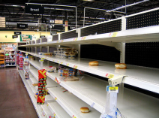
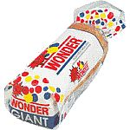

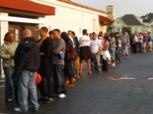

$0.50 Price Ceiling on Bread
Question | Explanation | In pictures
Will there be more or less bread for sale? | Consumers want to purchase more, but producers will manufacture less. Shortage! | Empty shelves
Will the size of a typical loaf change? | Manufacturers will try to maintain profits by reducing the size of each loaf. | No more giant loaves
Will the quality change? | Expensive brands will no longer be profitable to produce. | Focaccia bread would disappear
Will the opportunity cost of finding bread change? | Opportunity cost of finding bread will rise. Resources spent looking for bread in different stores and waiting in line. | Bread lines would become the norm
Would you buy illegal bread if you could? | Since bread is hard to find, and people still need it, a black market will develop. | Black market bread dealers reduce the shortage
Notes:
Lecture tip:
Click through to reveal the table one row at a time.
First click: More or less bread for sale?
Lower price increase quantity demand, decrease quantity supplied, so get a shortage.
Second click: Size of loaf
Gets smaller so that the firm can maintain some profits
Third click: Quality
Goes down as firms use cheaper ingredients
Fourth click: OC
The opportunity cost will be higher.
Note that once you include the OC of waiting in line, the full cost to the consumer will be more than the market price.
Fifth click: Illegal bread
Black markets may form.

Slide 10
The Effects of Price Ceilings
Three different situations:
  A nonbinding price ceiling
  A binding price ceiling
  Long-run effects of price ceiling
Notes:
Lecture tip:
The graphs on the next three slides will exemplify each of the situations.

Slide 11
1. Nonbinding Price Ceiling
Notes:
Image: Animated Figure 6.1
Lecture notes:
Without the price ceiling, P_{E} = $1 and Q_{E} is the equilibrium quantity.
First click:
Government imposes a $2.00 price ceiling.
Second click:
Shaded in area below $2.00: Any price <= $2.00 are legal.
Third click:
Shaded in area above $2.00: Any price > $2.00 illegal.
Since E occurs in the green area, the price ceiling does not influence the market; it is nonbinding.

Slide 12
2. Binding Price Ceiling
Notes:
Image: Animated Figure 6.2
Lecture notes:
This figure looks at the effect of a binding price ceiling in the short run.
Without the price ceiling, P_{E} = $1 and Q_{E} is the equilibrium quantity.
First click:
Government imposes a $0.50 price ceiling.
Second click:
Shaded in area below and above price ceiling.
Since E occurs in the red area, the price ceiling does influence the market; it is binding.
Third click:
Labels Q_{S} and Q_{D} and Shortage
At the price ceiling of $0.50, Q_{D} > Q_{S}, so there is a shortage of bread.
Note that this is a general consequence of a binding price ceiling (to get shortages).
At this point, you could discuss alternative rationing methods when there are shortages (such as waiting in line, ration coupons based on need, etc.).
Point out that in an uncontrolled market, price rations the good (i.e., if there was excess demand, price would increase to bring the market back to E).
Fourth click:
Labels black market price.
With only Q_{S} units available, consumers are willing and able to pay $2.00 per loaf.
This eliminates the shortage, but the price is well above the price ceiling.
You can go beyond the example above by proposing the following situation:
Suppose there was no black market, and the Q_{S} units of bread were allocated by consumers waiting in line.
What does the difference between the $2.00 and the ceiling price of $0.50 represent?

Slide 13
3. Price Ceilings in the Long Run
Notes:
Image: Animated Figure 6.3
Lecture notes:
The figure looks at the effect of a binding price ceiling in the long run.
Without the price ceiling, P_{E} = $1 and Q_{E} is the equilibrium quantity.
Since we are considering the long run, note that the demand and supply curves are more elastic. Ask students why they think that is.
Supply: bakers respond in the long run by producing less bread and making products that are not subject to price controls.
Demand: in the long run, consumers will attempt to take advantage of the price ceiling by changing eating habits to consume more bread.
First click:
Labels price ceiling and shaded areas
Second click:
Labels new Q_{S} and Q_{D} and new shortage.
So in the long run, the shortage gets larger.
Third click:
Adds black market price
Long run black market prices are less than before ($2.00).
Consumers have had time to find alternatives.

Slide 14
Practice What You Know—1
What will be the effect of a nonbinding price ceiling?
  A surplus will be created.
  A shortage will be created.
  There will be no effect.
  The effect is unknown.
Notes:
Clicker question:
Correct answer: C, There will be no effect.
If the price ceiling is nonbinding (above the equilibrium), the equilibrium price is already in the legal range, so nothing will change.

Slide 15
Practice What You Know—2
In the event of a binding price ceiling, what is one function that a black market serves?
  reduces the shortage caused by the price ceiling
  decreases the price even further
  creates a monopoly
  causes a surplus of the good
Notes:
Clicker question:
Correct answer: A, reduces the shortage caused by the price ceiling
More trading may illegally take place at higher prices with a black market.

Slide 16
Practice What You Know—3
Supply and demand generally become more elastic in the long run. This means that shortages caused by price ceilings _________ in the long run.
  disappear completely
  become smaller
  become larger
  become infinitely large
Notes:
Clicker question:
Correct answer: C, become larger
Q_{D} and Q_{S} will be more responsive to price changes when demand and supply are more elastic. Thus, shortages are made worse because Q_{D} rises faster and Q_{S} falls faster.

Slide 17

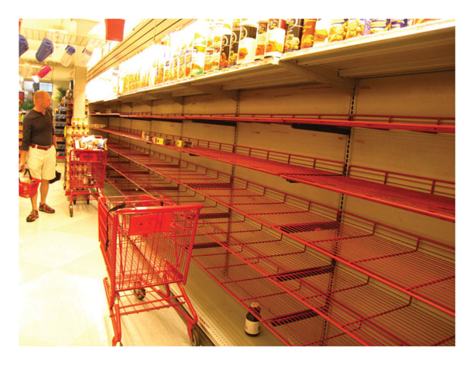
What Effects Do Price Ceilings Have on Economic Activity?
Two real-world examples:
  Rent control and price gouging
Notes:
Lecture notes:
Rent control:
Price ceiling that applies to the market for apartment rentals
Price gouging laws:
Temporary ceiling on the prices that sellers can charge during times of emergency

Slide 18
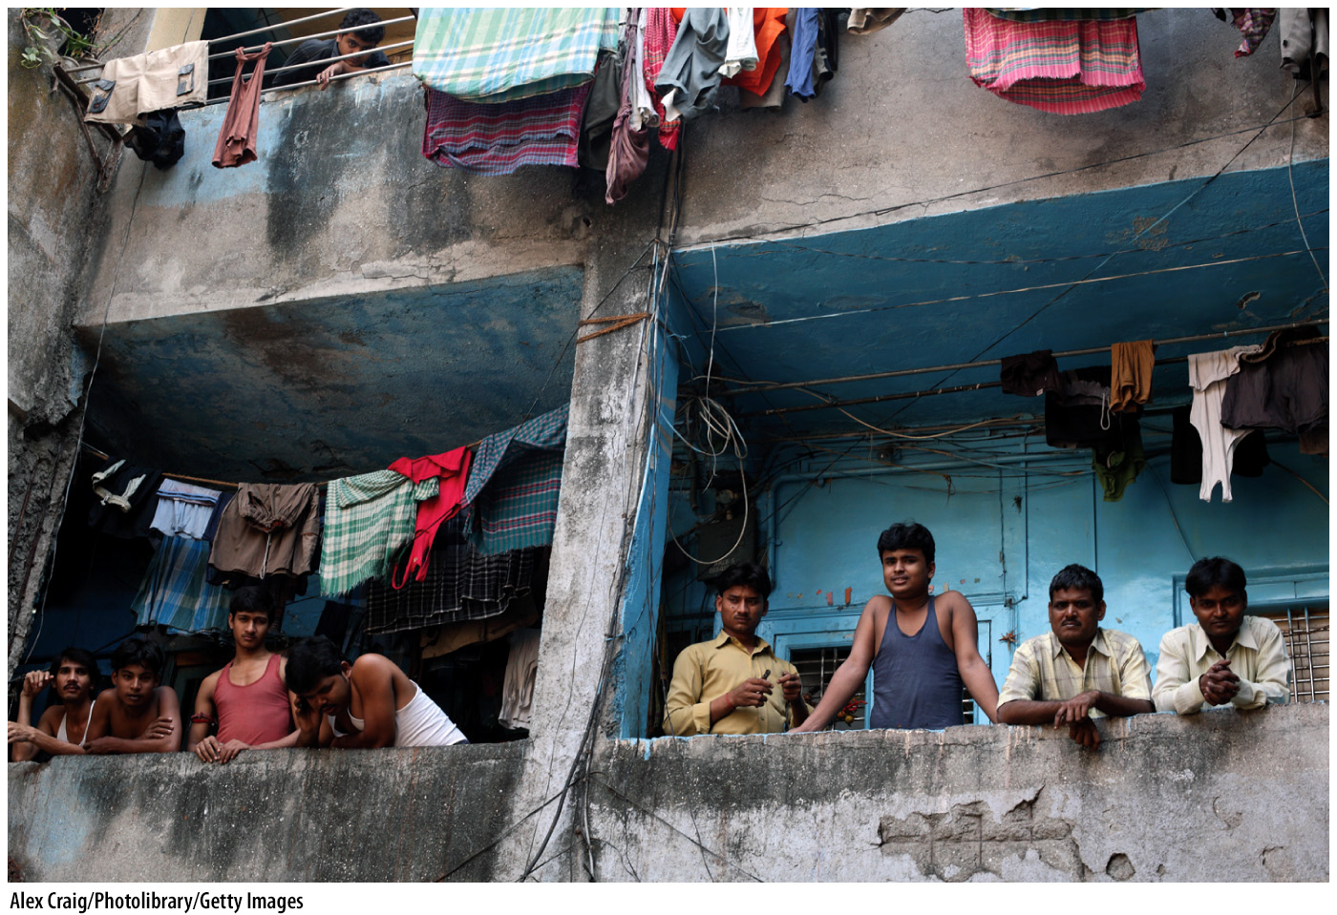
Rent Control—1
Besides shortages, what are some unintended consequences of rent controls?
  Reduction in quality of apartments:
    Either less maintenance or decay
Notes:
Lecture notes:
Shortage, since Q_{D} > Q_{S}.
Since the rent control is so low, owners have less revenue for maintenance.
To make a reasonable profit, rent control policies have led to the decay of many apartment buildings.
The image on the slide is a picture is of apartment building in Mumbai, India.

Slide 19
Rent Control—2
What are some other unintended consequences of rent controls?
  Landlords “nickel and dime” tenants with fees to increase revenues
  Decreases in long-term investment in the
  building of new units
  Policy often ends up hurting the very people it was supposed to help
Notes:
Lecture notes:
Although the law limits the rent that landlords may charge, landlords can charge “add-on fees,” key fees, and high security deposits.
If there are rent controls, there is less incentive to invest in building new unit, which makes the shortage worse in the long run.
Other consequences can include:
It provides an incentive for people to stay in rent-controlled housing longer than they would have otherwise.
Rent-controlled apartments are passed from one generation to the next in order to remain in the program, so many people who live in rent-controlled apartments are no longer low income.
Owners of rent controlled buildings may convert them to other uses (i.e., turn them into condos).

Slide 20
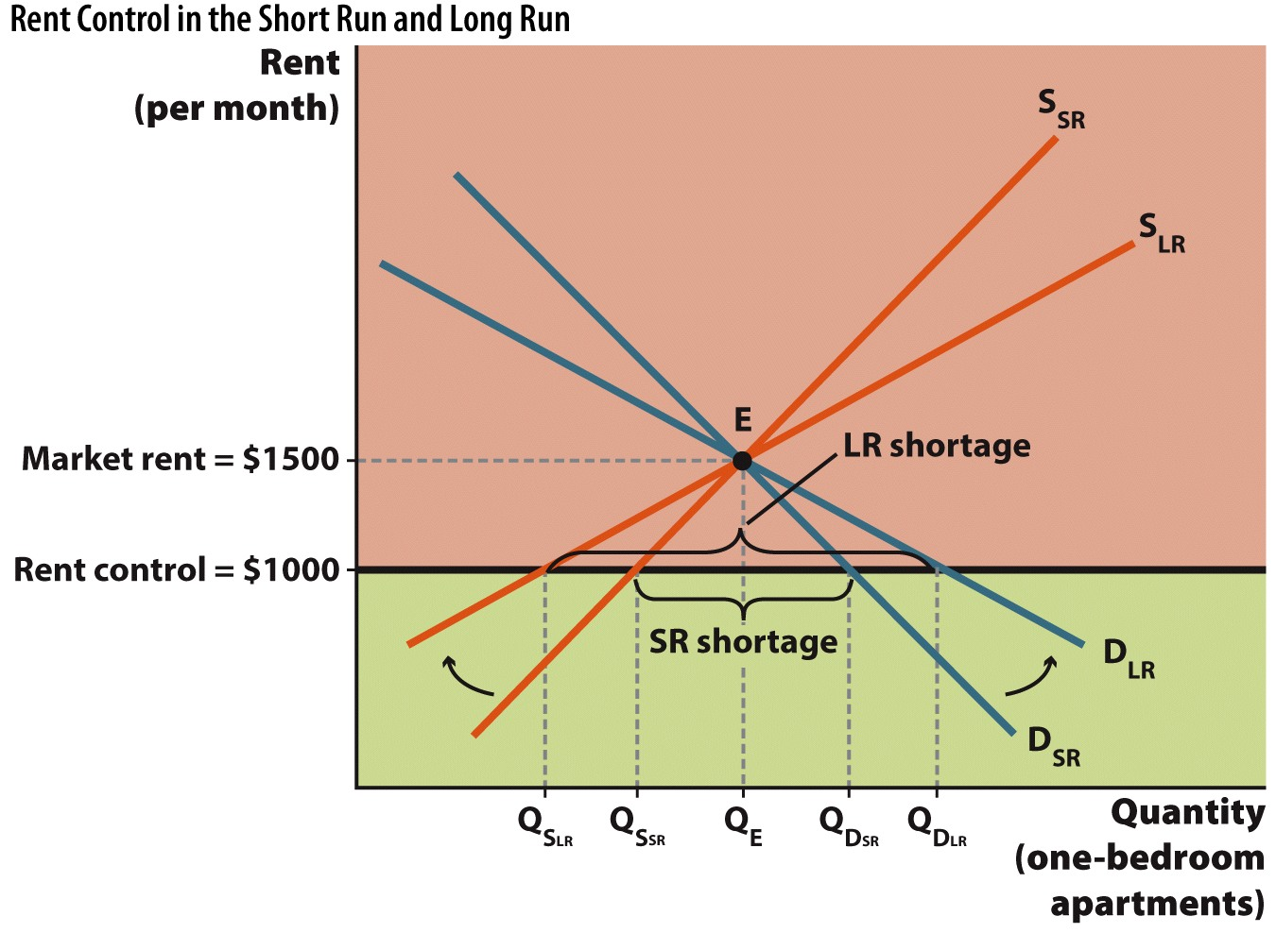
Rent Control in the Short Run and Long Run
Notes:
Image: Figure 6.4
Lecture notes:
In the short run, the shortage = Q_{D,SR} – Q_{S,SR}.
In the long run, both supply and demand become more elastic.
Suppliers have more time to adjust, and the quantity of apartments supplied falls.
Renters try to substitute toward renting rent-controlled apartments so the quantity of apartments demanded rises.
So, shortage gets bigger in the long run.

Slide 21
Practice What You Know—4
What is one unintended consequence of rent control?
  People in rent-controlled units will relocate more often.
  Landlords may not maintain rental units.
  Too many apartments will be built, creating a surplus of units.
  People will choose not to live in big cities.
Notes:
Clicker question:
Correct answer: B, Landlords may not maintain rental units.
With artificially low prices, the landlords may decide it is not worth the time or effort to keep units clean and fixed.

Slide 22
Economics in Seinfeld, “The Apartment”
How much does that rent-controlled apartment cost?
Notes:
“Economics in the Media” Slide
Lecture notes:
The clip mentioned on the slide can be found in the Interactive Instructor’s Guide. Access the direct link by clicking the icon in the PowerPoint above.
In this clip, rent control is $400 per month, but Elaine would have had to pay $5,000 to get it.

Slide 23

Price Gouging—1
Price-gouging laws
  Temporary price ceilings imposed during emergencies
  Imagine that there’s a severe hurricane. How would an uncontrolled market deal with an increase in the demand for generators?
Notes:
Lecture notes:
Make sure students don’t confuse “price gouging” with paying prices that consumers think are “too high.”
$10 for a soda at a movie? We often willingly purchase goods, even if we think they are too expensive.
To complete the scenario outlined on the slide:
Because of the hurricane, the demand for generators increases.
At the initial price, there would be an excess demand for generators.
Remember that prices act to ration scarce resources.
So, with excess demand, the price of a generator increases.
This ensures that the available units are distributed to those who value them the most.
The higher price also provides suppliers with an incentive to provide more generators.
This is how markets are supposed to work.
[© Lisa F. Young | Dreamstime.com]

Slide 24
Price Gouging—2
Price-gouging laws
  Temporary price ceilings imposed during emergencies
  Imagine that there’s a severe hurricane. How would an uncontrolled market deal with an increase in the demand for generators?
  What are the consequences of
  price-gouging laws?
Notes:
Lecture notes:
The direct result of price gouging laws is a shortage.
Other consequences include:
Entrepreneurial activity that could alleviate some of the problems reduced.
The text uses an example of someone trucking generators from a state not affected by the hurricane.
The end result is that there are delays in helping affected areas.
[© Lisa F. Young | Dreamstime.com]

Slide 25
Price Gouging—3
Notes:
Image: Animated Figure 6.5
Lecture notes:
Initial market equilibrium:
P = $530 and Q_{before}.
First click:
Demand increases because of the hurricane.
New equilibrium: P $900, and Q_{after}.
This is what would happen if there were no controls.
Second click:
Government sets a price ceiling below $900 but above $530: P_{maximum under gouging}.
Note that since P_{Max} is greater than the normal price of $530, it is nonbinding during normal times.
Third click:
Shaded in areas above and below maximum price.
Fourth click:
Labels shortage.
Since the price ceiling is less than the equilibrium price, there is a shortage.

Slide 26
Economics in ABC News, “Stossel in the Classroom”
Is price gouging bad?
Notes:
“Economics in the Media” Slide
Lecture tip:
The clip mentioned on the slide can be found in the Interactive Instructor’s Guide. Access the direct link by clicking the icon in the PowerPoint above.
The key concepts covered by this clip are:
Price ceiling
Price gouging
The clip includes such examples as price gouging after Hurricane Katrina and a Mississippi price gouging law.
Economists argue price gouging is good since the higher prices (without the law) provide people incentives to bring necessary items to people in need.

Slide 27
Economics in The Simpsons, “Much Apu About Nothing”
Is this price gouging?
Notes:
“Economics in the Media” Slide
Lecture tip:
The clip mentioned on the slide can be found in the Interactive Instructor’s Guide. Access the direct link by clicking the icon in the PowerPoint above.
The key concepts covered by this clip are:
Supply
Demand
Equilibrium price
Price gouging

Slide 28
A Proposal and Counterproposal
In order to protect consumers from excessively high prices, a city government will impose a price-gouging law on snow shovels, deicer, and so on during severe winters.
In order to protect producers from excessively low prices, a city government will impose a price-collapsing law on snow shovels, deicer, and so on, during unusually mild winters.
Notes:
Lecture tip:
Feel free to write in a specific city (you may have to adjust the example though).
Use this as a counter example for students who are still not convinced that price gouging is okay.
Ask students which proposal would they vote for. Hopefully, neither; if they disagree with one of them, they should disagree with both.
It also might be a good point to re-emphasize to students that market forces are impersonal.
Ask students to think about gasoline prices.
When there is a supply disruption and prices for gasoline jump, you get the inevitable local news story at a gas station. A reporter interviews a customer who blames greedy gasoline companies. “They’re just trying to gouge us so they can make more profit.” I have yet to see a news story when market forces drive the price of gasoline to low levels.
Shouldn’t there be a customer thanking gas companies for not putting profits ahead of people?

Slide 29
When Do Price Floors Matter?
Recall that a price floor is the minimum legal price.
Why does the government impose price floors?
Again, think about the unintended consequences.
Notes:
Lecture tip:
Reiterate the difference between the definition of a “price floor” and an “effective price floor.”
Some examples include:
Minimum wage
Agriculture

Slide 30
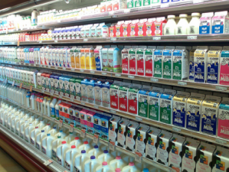
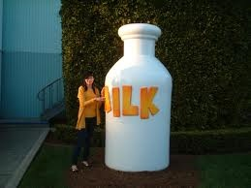

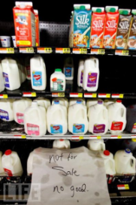
Another Thought Experiment:
$6 Price Floor on Milk
Question | Explanation | In pictures
Will the quantity of milk for sale change? | Consumers will purchase less but producers will manufacture more. Surplus! | There will be a surplus of milk
Will the size of a typical container change? | Since the price floor is $6.00, manufacturers can make their product more attractive by increasing the size of each container. | Milk containers would get bigger
Would producers sell below the price floor? | Due to the surplus, sellers would have a strong incentive to undercut the price floor in order to avoid having to discard leftover milk. | Illegal discounts would help to reduce the milk surplus
Are milk producers better off? | Not if they have trouble selling what they produce. | There will be a lot of spoiled milk
Notes:
Lecture tip:
Click through to reveal the table one row at a time.
First click:
More or less milk for sale?
Higher price reduces quantity demand and increases quantity supplied, so we get a surplus.
Second click:
Size of container gets larger to make more attractive
Third click:
Will milk sell for a price below floor?
Yes, since producers won’t want to hold on to surplus milk.
Fourth click:
Are producers better off?
It depends. Can they sell the surplus at lower prices? Does the government buy the surplus?

Slide 31
The Effects of Price Floors
Three different situations:
  A nonbinding price floor
  A binding price floor
  Long-run effects of price floor
Notes:
Lecture notes:
The graphs on the next three slides will exemplify each of the situations.

Slide 32
1. Nonbinding Price Floor
Notes:
Image: Animated Figure 6.6
Lecture notes:
Without the price ceiling, P_{E} = $3, and Q_{E} is the equilibrium quantity.
First click:
Government imposes a $2.00 price ceiling.
Second click:
Shaded in area below $2.00: any price < $2.00 is illegal.
Third click:
Shaded in area above $2.00: any price > = $2.00 is legal.
Since E occurs in the green area, the price floor does not influence the market; it is nonbinding.

Slide 33
2. Binding Price Floor
Notes:
Image: Animated Figure 6.7
Lecture notes:
This figure looks at the effect of a binding price floor in the short run.
Without the price floor, P_{E} = $3, and Q_{E} is the equilibrium quantity.
First click:
Government imposes a $6.00 price floor.
Second click:
Shaded in area below and above price floor.
Since E occurs in the red area, the price floor does influence the market; it is binding.
Third click:
Labels Q_{S}, Q_{D}, and surplus.
At the price floor of $6.00, Q_{S} > Q_{D}, so there is a surplus of milk.
Note that this is a general consequence of a binding price floors (to get surplus).
Fourth click:
Labels black market price.
With Q_{S} units produced, consumers are only willing and able to pay $2.00 per gallon.
This eliminates the surplus, but the price is well below the price floor.
You can go beyond the example above by proposing the following situation:
Suppose there was no black market, and the Q_{S} units of bread where allocated by consumers waiting in line.
What does the difference between the $2.00 and the ceiling price of $0.50 represent?

Slide 34
3. Binding Price Floor in the Long Run
Notes:
Image: Animated Figure 6.8
Lecture notes:
This figure looks at the effect of a binding price ceiling in the long run.
Without the price ceiling, P_{E} = $3 and Q_{E} is the equilibrium quantity.
Since we are considering the long-run note that the demand and supply curves are more elastic, ask students why they think that is.
Supply: dairy farms respond in the long run by acquiring more land and expanding production facilities so they can produce more milk.
Demand: in the long run, consumers will find milk substitutes.
First click:
Labels price ceiling and shaded areas.
Second click:
Labels new Q_{S}, Q_{D}, and surplus.
So, in the long run, the shortage gets larger.
Third click:
Adds new black market price.
Long-run black market price is less than before ($2.00).
The increased elasticity on the part of both producers and consumers makes the surplus larger in the long run.

Slide 35
Economics in Mary Poppins Quits
Poppins can’t survive on the federal minimum wage.
Notes:
“Economics in the Media” Slide
Lecture tip:
The clip mentioned on the slide can be found in the Interactive Instructor’s Guide. Access the direct link by clicking the icon in the PowerPoint above.
The key concepts covered in this clip are:
Minimum wage
Living wage
Price floors

Slide 36
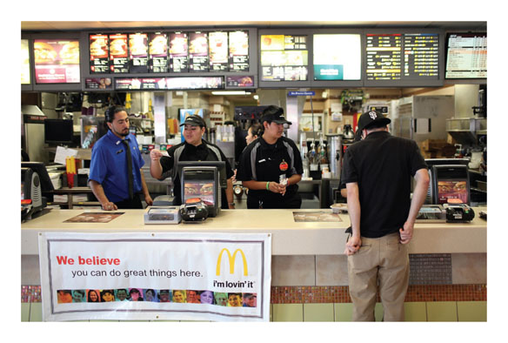
Minimum Wage—1
Minimum wage
  The lowest hourly wage
  rate that firms may legally
  pay their workers
Rationale for minimum wage:
  Provide a “living wage”
  Help the working poor who are often unskilled
  Provides skills, experience
Notes:
Lecture notes:
Ask students if any of them work at a minimum-wage job.
Do they fit any of the rationales listed above?
Then, ask them about fast-food restaurants. Which jobs are getting eliminated?
[Justin Sullivan/Getty Images]

Slide 37
Labor Markets: A Review
In the market for goods and services, households demand goods; firms supply goods.
In the market for labor, households supply labor; firms demand labor.
  The demand curve for labor is downward-sloping.
  The supply curve for labor is generally upward-sloping.
Notes:
Lecture notes:
As wages increase (decrease), the quantity of labor demanded decreases (increases).
As wages increase (decrease), the quantity of labor supplied increases (decreases). No need to get into backward-bending labor supply curves at this point.

Slide 38
Binding Minimum Wage
Notes:
Image: Animated Figure 6.9
Lecture notes:
Without the minimum wage, W_{E} = $7 and Q_{E} is the equilibrium quantity (short run).
First click:
Government imposes a $10.00 minimum wage.
Second click:
Shaded in area below and above $10.00.
Any wage < $10.00 is illegal; any wage > = $10.00 is legal.
E occurs in red area: the minimum wage does influence the market; it is binding.
Third click:
Labels the Q_{D}, Q_{S}, and the SR unemployment.
The increase in the wage that firms have to pay reduces Q_{D}.
The increase in the wage also increases Q_{S}.
The result is a surplus of workers or unemployment.
Fourth click: Long run
Draws long-run demand and supply; both are more elastic.
Demand is more elastic in the long run since firms have more time to adjust to higher wage (by replacing workers with machines, for example).
Supply is more elastic since it is now more attractive to work (as opposed to being retired or in school, for example).
Fifth click:
Labels the Q_{D}, Q_{S}, and the LR unemployment.
In the long run, unemployment is greater than in the short run.
Long run versus short run:
At this point, you could discuss the difficulties in estimating how much unemployment is caused by the minimum wage.
In the short run, demand for labor tends to be relatively inelastic, so firms cannot quickly replace workers. The same is not true in the long run.

Slide 39
Minimum Wage—2
Causes of the unemployment created by minimum wage:
  Decrease in Q_{D} of labor and increase in Q_{S} of labor
  Firms may replace low-skilled jobs with capital
Notes:
Lecture notes:
Some example of firms replacing low-skilled jobs with capital can include:
Automated ordering at fast-food restaurants
Modern garbage trucks no longer need as many workers
Note that as minimum wage increases, capital becomes relatively cheaper, so firms substitute capital for labor.
Higher wages also provide incentives for entrepreneurs to develop labor-saving capital.

Slide 40
Minimum Wage—3
Causes of the unemployment created by minimum wage:
  Decrease in Q_{D} and increase in Q_{S} of labor
  Firms may replace low-skilled jobs with capital
  Shortening hours for workers
  Firms may relocate where no minimum wage
Proponents of minimum wage advocate
  Training, education, job programs
Notes:
Lecture tip:
You could also discuss how the minimum wage changes hiring decisions by firms in the long run.
Who gets hired?

Slide 41
Nonbinding Minimum Wage—1
What happens if the minimum wage is below the market equilibrium wage?

Slide 42
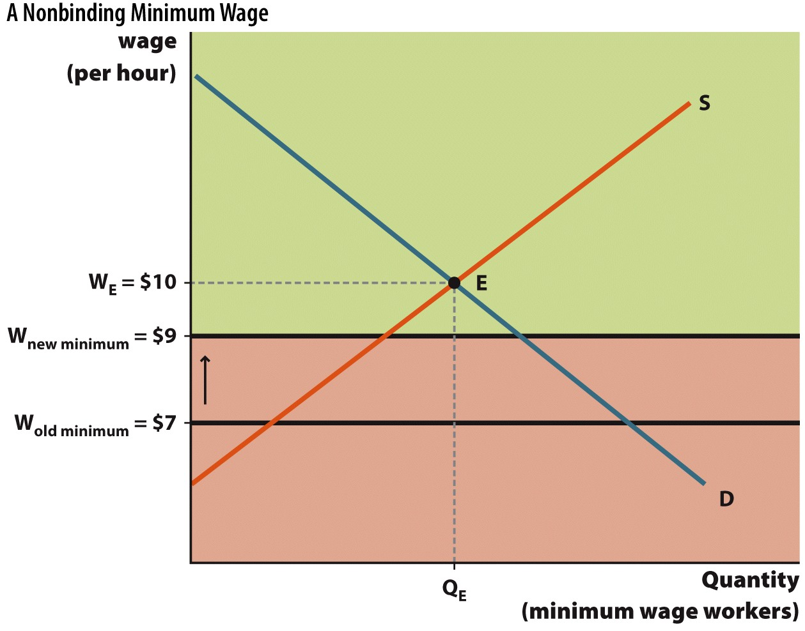
Nonbinding Minimum Wage—2
Notes:
Image: Figure 6.10
Lecture notes:
Without a minimum wage, W_{E} = $10 and Q_{E} is the equilibrium quantity. The old minimum wage is $7.
The government increases the minimum wage to $9.
Since the new minimum wage is still below the equilibrium wage, there is no effect.

Slide 43
Nonbinding Minimum Wage—3
Why would the government impose a nonbinding minimum wage?
Notes:
Lecture notes:
The government might impose a nonbinding minimum wage for politically motivated reasons—by increasing the minimum wage, politicians win support from voters.
But by making it nonbinding, the government avoids the negative consequences.
Increases in minimum wage tend to lag increases in the market wage.

Slide 44
Economics in Boston Legal, “Can’t We All Get a Lung?”
Should we allow people to sell their organs?
Notes:
“Economics in the Media” Slide
Lecture tip:
The clip mentioned on the slide can be found in the Interactive Instructor’s Guide. Access the direct link by clicking the icon in the PowerPoint above.
This specific example may be out of place since it deals with price ceilings, but it could be a nice way to think about more serious issues.
The key concepts covered in this clip are:
Black market
Health economics
Shortage
Price celling
You can follow up this clip by bringing up the following points and asking students these questions:
By not allowing the sale of organs, the effective price of a kidney is $0.
This is a price ceiling, so you get a shortage of kidneys.
What are the economic/ethical implications of allowing people to buy/sell organs?
Real-world example: The Pros and Cons of Trading Human Organs (See Tip #232)
This could be a useful follow-up to the Boston Legal clip, as it provides real-world examples (including the pros and cons) of trading human organs. This tip also includes some suggested reading:
(On the pros)
Sally Satel, “Death’s Waiting List,” New York Times, May 15, 2006, nytimes.com.
“Facts and Myths,” American Transplant Foundation, americantransplantfoundation.org.
(On the cons)
Lily Yan, “Illegal Online Trade in Organs Booms in China,” Radio Australia, November 16, 2009, radioaustralia.net.au.

Slide 45
Conclusion
Prices act as signals and give information to consumers and producers.
Price controls can distort the signals.
Price controls lead to unintended consequences.
Notes:
Lecture notes:
One of the main roles of prices is that they signal the relative scarcity of different goods.
They also provide consumers and producers information on how to act.
Price controls lead consumers and producers to act in ways that they would not have done without the control.
Make sure to review some unintended consequences.
You can summarize the lecture on this chapter by reiterating the following points:
A price ceiling is a legally imposed maximum price.
The direct consequence is a shortage.
But there are also unintended consequences.
A price floor is a legally imposed minimum price.
The direct consequence is a surplus.
As with ceilings, there are also unintended consequences.
Lastly, as a final thought, you can discuss this F. A. Hayek quote: “The curious task of economics is to demonstrate to men how little they really know about what they imagine they can design.”

